Slide 1
Decision Tree based Methods
&
Ensemble Classifiers:
Boosting, Bagging, Random Forests

Slide 2
Classification: Definition
Given a collection of records (training set )
Each record is by characterized by a tuple (x,y), where x is the attribute set and y is the class label
x: attribute, predictor, independent variable, input
y: class, response, dependent variable, output
Task:
Learn a model that maps each attribute set x into one of the predefined class labels y

Slide 3
General Approach for Building Classification Model

Slide 4
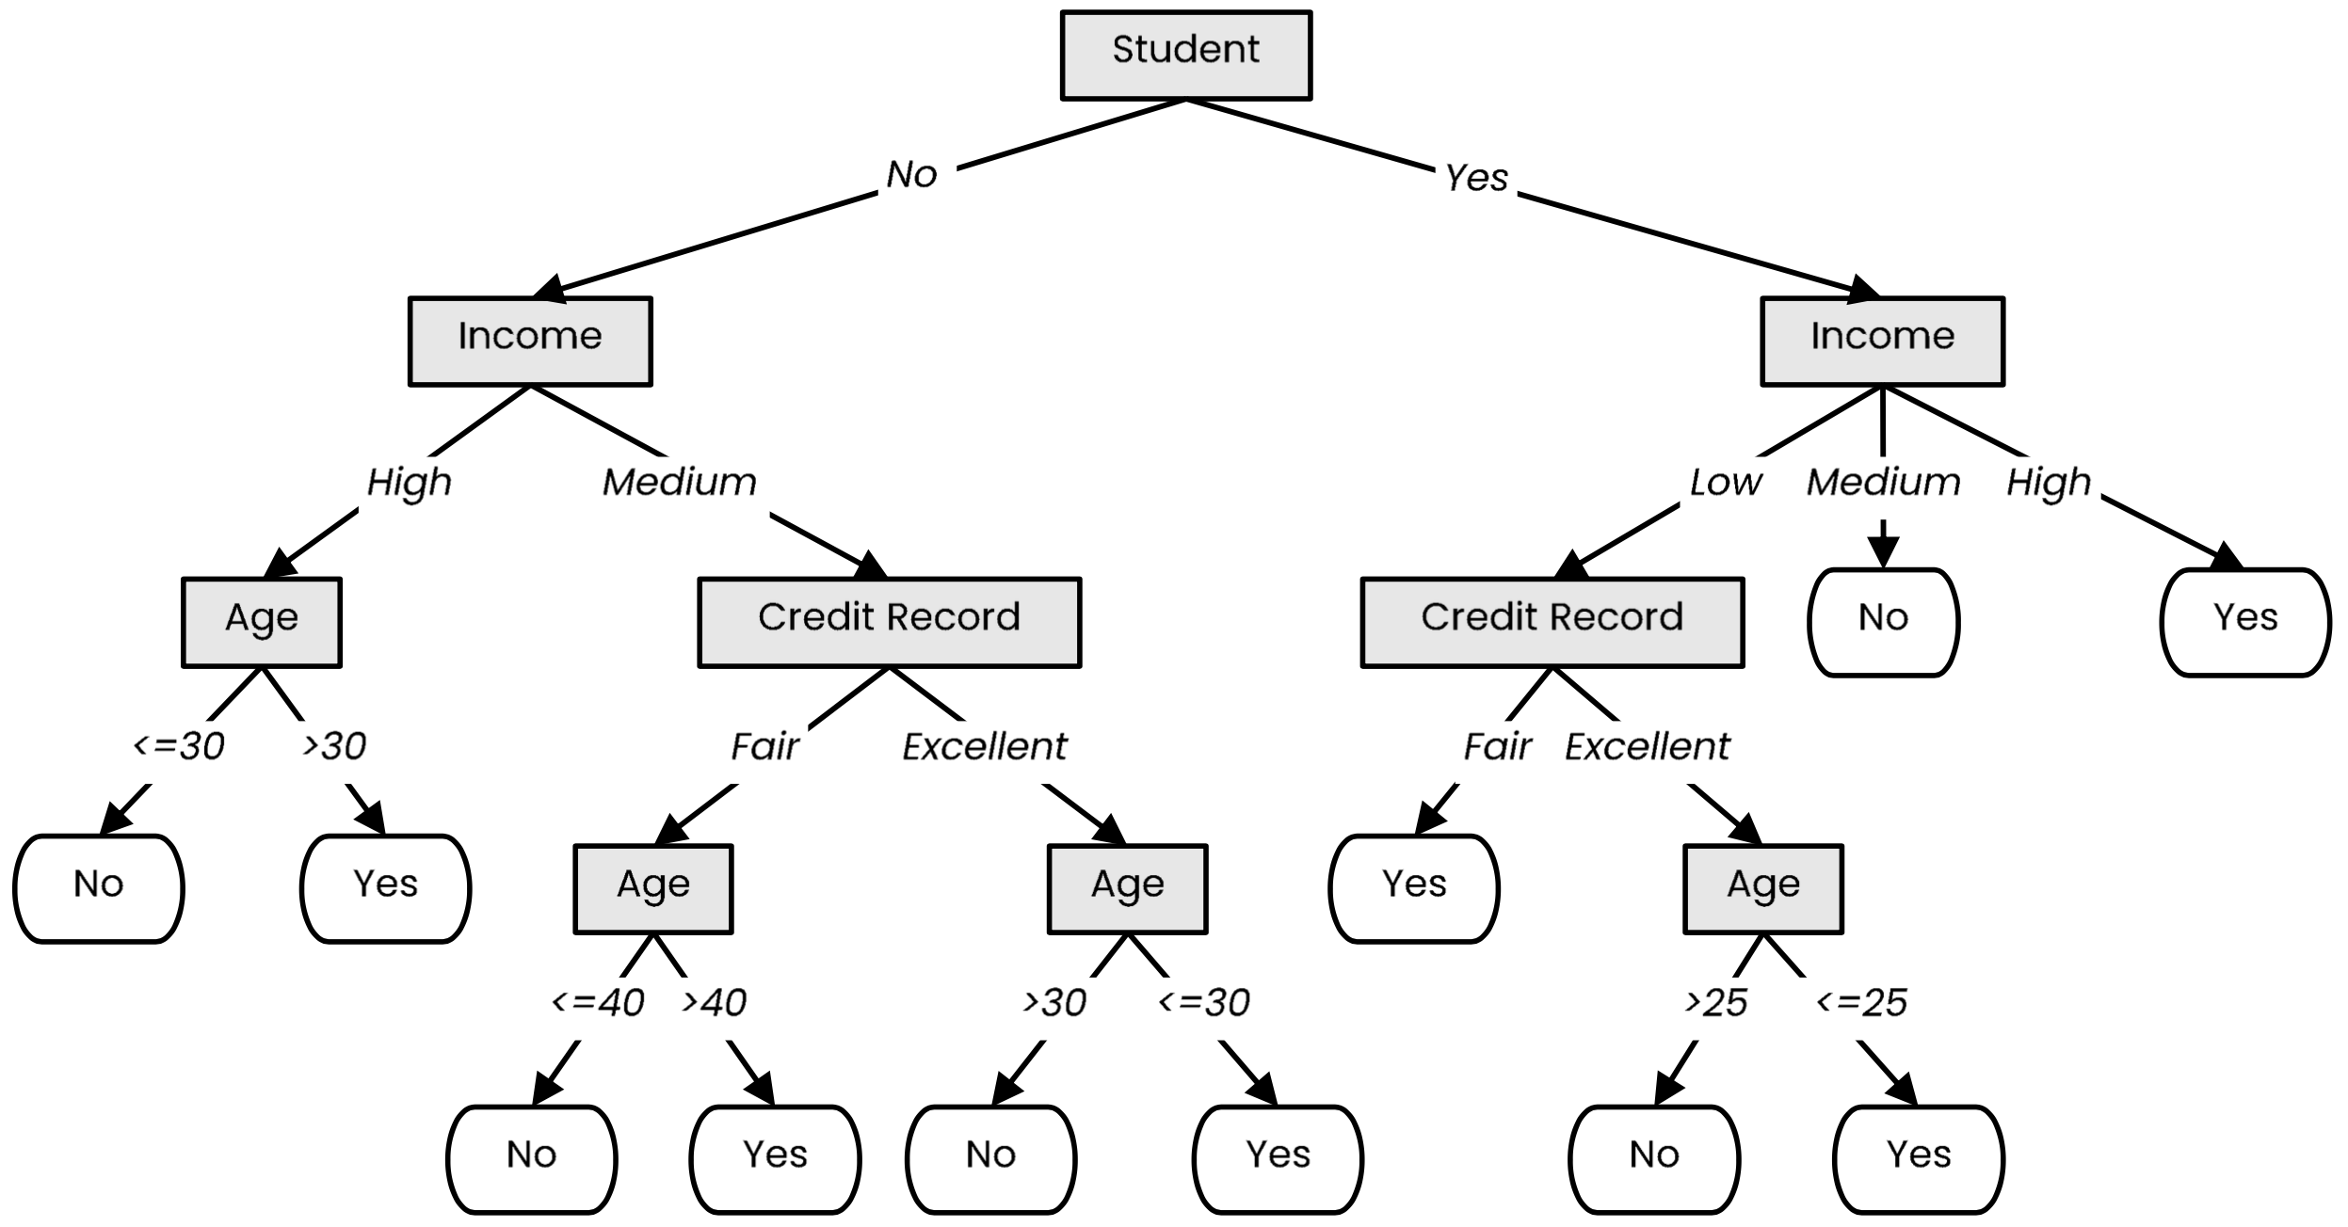
Definition
A tree-like model that illustrates series of events leading to certain decisions
Each node represents a test on an attribute and each branch is an outcome of that test
Who to loan?
Not a student
45 years old
Medium income
Fair credit record
Student
27 years old
Low income
Excellent credit record

Slide 5
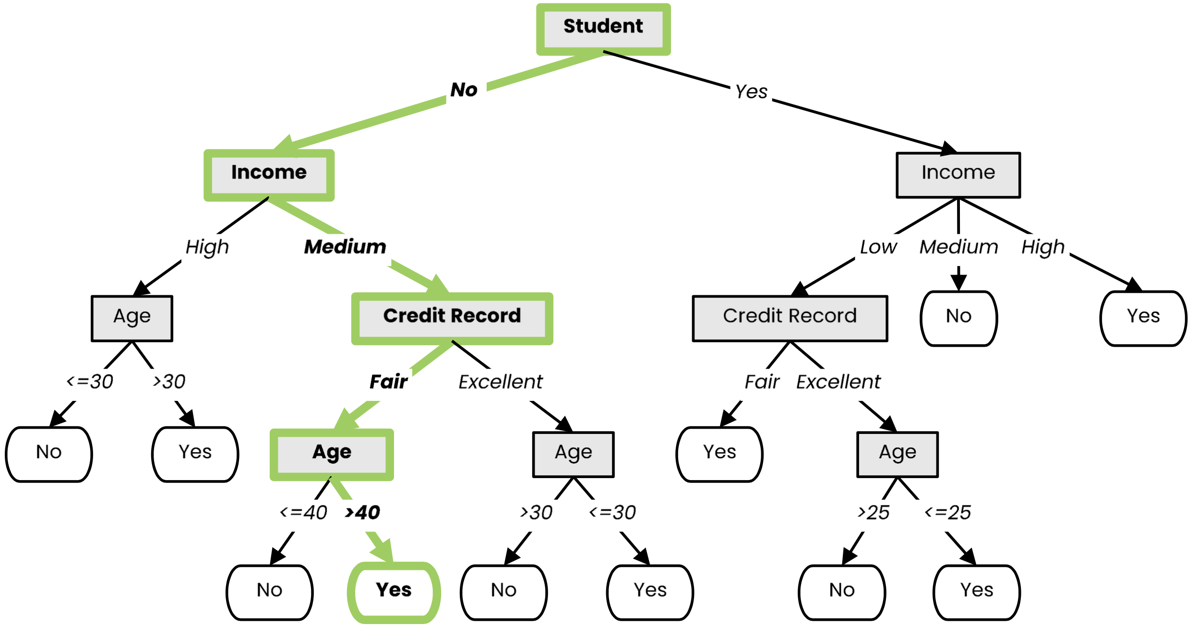
Definition
A tree-like model that illustrates series of events leading to certain decisions
Each node represents a test on an attribute and each branch is an outcome of that test
Who to loan?
Not a student
45 years old
Medium income
Fair credit record
Yes
Student
27 years old
Low income
Excellent credit record

Slide 6
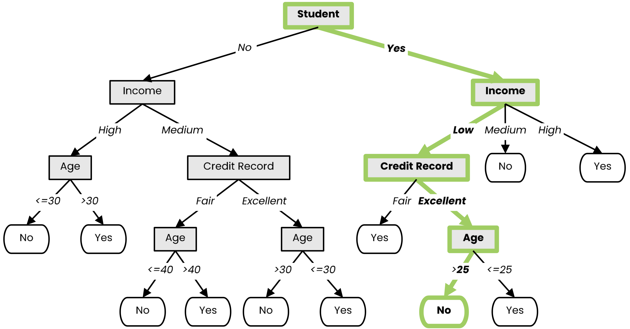
Definition
A tree-like model that illustrates series of events leading to certain decisions
Each node represents a test on an attribute and each branch is an outcome of that test
Who to loan?
Not a student
45 years old
Medium income
Fair credit record
Yes
Student
27 years old
Low income
Excellent credit record
No

Slide 7
Example of a Decision Tree
categorical
categorical
continuous
class
Splitting Attributes
Home Owner
Yes
No
NO
MarSt
Single, Divorced
Married
Income
NO
< 80K
> 80K
NO
YES
Training Data
Model: Decision Tree

Slide 8
Another Example of Decision Tree
categorical
categorical
continuous
class
Single, Divorced
MarSt
Married
NO
Home Owner
Yes
No
NO
Income
< 80K
> 80K
NO
YES
There could be more than one tree that fits the same data!

Slide 9
Apply Model to Test Data
Test Data
Start from the root of tree.
Home Owner
Yes
No
NO
MarSt
Single, Divorced
Married
Income
NO
< 80K
> 80K
NO
YES

Slide 10
Apply Model to Test Data
Test Data
Home Owner
Yes
No
NO
MarSt
Single, Divorced
Married
Income
NO
< 80K
> 80K
NO
YES

Slide 11
Apply Model to Test Data
Test Data
Home Owner
Yes
No
NO
MarSt
Single, Divorced
Married
Income
NO
< 80K
> 80K
NO
YES

Slide 12
Apply Model to Test Data
Test Data
Home Owner
Yes
No
NO
MarSt
Single, Divorced
Married
Income
NO
< 80K
> 80K
NO
YES

Slide 13
Apply Model to Test Data
Test Data
Home Owner
Yes
No
NO
MarSt
Single, Divorced
Married
Income
NO
< 80K
> 80K
NO
YES

Slide 14
Apply Model to Test Data
Test Data
Home Owner
Yes
No
NO
MarSt
Single, Divorced
Married
Assign Defaulted to “No”
Income
NO
< 80K
> 80K
NO
YES

Slide 15
Decision Tree Classification Task
Decision Tree

Slide 16
Decision Tree Induction
Many Algorithms:
Hunt’s Algorithm (one of the earliest)
CART
ID3, C4.5
SLIQ,SPRINT

Slide 17
General Structure of Hunt’s Algorithm
Let D_{t} be the set of training records that reach a node t
General Procedure:
If D_{t} contains records that belong the same class y_{t}, then t is a leaf node labeled as y_{t}
If D_{t} contains records that belong to more than one class, use an attribute test to split the data into smaller subsets. Recursively apply the procedure to each subset.
D_{t}
?

Slide 18
Hunt’s Algorithm
(7,3)
(3,0)
(4,3)
(3,0)
(3,0)
(3,0)
(1,3)
(3,0)
(1,0)
(0,3)

Slide 19
Hunt’s Algorithm
(7,3)
(3,0)
(4,3)
(3,0)
(3,0)
(3,0)
(1,3)
(3,0)
(1,0)
(0,3)

Slide 20
Hunt’s Algorithm
(7,3)
(3,0)
(4,3)
(3,0)
(3,0)
(3,0)
(1,3)
(3,0)
(1,0)
(0,3)

Slide 21
Hunt’s Algorithm
(7,3)
(3,0)
(4,3)
(3,0)
(3,0)
(3,0)
(1,3)
(3,0)
(1,0)
(0,3)

Slide 22
Design Issues of Decision Tree Induction
How should training records be split?
Method for specifying test condition
depending on attribute types
Measure for evaluating the goodness of a test condition
How should the splitting procedure stop?
Stop splitting if all the records belong to the same class or have identical attribute values
Early termination

Slide 23
Methods for Expressing Test Conditions
Depends on attribute types
Binary
Nominal
Ordinal
Continuous
Depends on number of ways to split
2-way split
Multi-way split

Slide 24
Test Condition for Nominal Attributes
Multi-way split:
Use as many partitions as distinct values.
Binary split:
Divides values into two subsets

Slide 25
Test Condition for Ordinal Attributes
Multi-way split:
Use as many partitions as distinct values
Binary split:
Divides values into two subsets
Preserve order property among attribute values
This grouping violates order property

Slide 26
Test Condition for Continuous Attributes

Slide 27
How to determine the Best Split
Greedy approach:
Nodes with purer class distribution are preferred
Need a measure of node impurity:
High degree of impurity
Low degree of impurity

Slide 28
Measures of Node Impurity
Gini Index
Entropy
Misclassification error

Slide 29
Finding the Best Split
Compute impurity measure (P) before splitting
Compute impurity measure (M) after splitting
Compute impurity measure of each child node
M is the weighted impurity of children
Choose the attribute test condition that produces the highest gain or equivalently, lowest impurity measure after splitting (M)
Gain = P – M

Slide 30
Finding the Best Split
Before Splitting:
P
A?
B?
Yes
No
Yes
No
Node N1
Node N2
Node N3
Node N4
M11
M12
M21
M22
M1
M2
Gain = P – M1 vs P – M2

Slide 31
Measure of Impurity: GINI
Gini Index for a given node t :
(NOTE: p( j | t) is the relative frequency of class j at node t).
Maximum (1 - 1/n_{c}) when records are equally distributed among all classes, implying least interesting information
Minimum (0.0) when all records belong to one class, implying most interesting information

Slide 32
Measure of Impurity: GINI
Gini Index for a given node t :
(NOTE: p( j | t) is the relative frequency of class j at node t).
For 2-class problem (p, 1 – p):
GINI = 1 – p² – (1 – p)² = 2p (1-p)

Slide 33
Computing Gini Index of a Single Node
P(C1) = 0/6 = 0 P(C2) = 6/6 = 1
Gini = 1 – P(C1)² – P(C2)² = 1 – 0 – 1 = 0
P(C1) = 1/6 P(C2) = 5/6
Gini = 1 – (1/6)² – (5/6)² = 0.278
P(C1) = 2/6 P(C2) = 4/6
Gini = 1 – (2/6)² – (4/6)² = 0.444

Slide 34
Computing Gini Index for a Collection of Nodes
When a node p is split into k partitions (children)
where, n_{i} = number of records at child i,
n = number of records at parent node p.
Choose the attribute that minimizes weighted average Gini index of the children
Gini index is used in decision tree algorithms such as CART, SLIQ, SPRINT

Slide 35
Binary Attributes: Computing GINI Index
Splits into two partitions
Effect of Weighing partitions:
Larger and Purer Partitions are sought for.
B?
Yes
No
Node N1
Node N2
Gini(N1) = 1 – (5/6)² – (1/6)² = 0.278
Gini(N2) = 1 – (2/6)² – (4/6)² = 0.444
Weighted Gini of N1 N2 = 6/12 * 0.278 + 6/12 * 0.444 = 0.361
Gain = 0.486 – 0.361 = 0.125

Slide 36
Measure of Impurity: Entropy
Entropy at a given node t:
(NOTE: p( j | t) is the relative frequency of class j at node t).
Maximum (log n_{c}) when records are equally distributed among all classes implying least information
Minimum (0.0) when all records belong to one class, implying most information
Entropy based computations are quite similar to the GINI index computations

Slide 37
Computing Entropy of a Single Node
P(C1) = 0/6 = 0 P(C2) = 6/6 = 1
Entropy = – 0 log 0 – 1 log 1 = – 0 – 0 = 0
P(C1) = 1/6 P(C2) = 5/6
Entropy = – (1/6) log₂ (1/6) – (5/6) log₂ (1/6) = 0.65
P(C1) = 2/6 P(C2) = 4/6
Entropy = – (2/6) log₂ (2/6) – (4/6) log₂ (4/6) = 0.92

Slide 38
Computing Information Gain After Splitting
Information Gain:
Parent Node, p is split into k partitions;
n_{i} is number of records in partition i
Choose the split that achieves most reduction (maximizes GAIN)
Used in the ID3 and C4.5 decision tree algorithms

Slide 39
Gain Ratio
Gain Ratio:
Parent Node, p is split into k partitions
n_{i} is the number of records in partition i
Adjusts Information Gain by the entropy of the partitioning (SplitINFO).
Higher entropy partitioning (large number of small partitions) is penalized!
Used in C4.5 algorithm
Designed to overcome the disadvantage of Information Gain

Slide 40
Gain Ratio
Gain Ratio:
Parent Node, p is split into k partitions
n_{i} is the number of records in partition i
SplitINFO = 1.52
SplitINFO = 0.72
SplitINFO = 0.97

Slide 41
Measure of Impurity: Classification Error
Classification error at a node t :
Maximum (1 - 1/n_{c}) when records are equally distributed among all classes, implying least interesting information
Minimum (0) when all records belong to one class, implying most interesting information

Slide 42
Computing Error of a Single Node
P(C1) = 0/6 = 0 P(C2) = 6/6 = 1
Error = 1 – max (0, 1) = 1 – 1 = 0
P(C1) = 1/6 P(C2) = 5/6
Error = 1 – max (1/6, 5/6) = 1 – 5/6 = 1/6
P(C1) = 2/6 P(C2) = 4/6
Error = 1 – max (2/6, 4/6) = 1 – 4/6 = 1/3

Slide 43
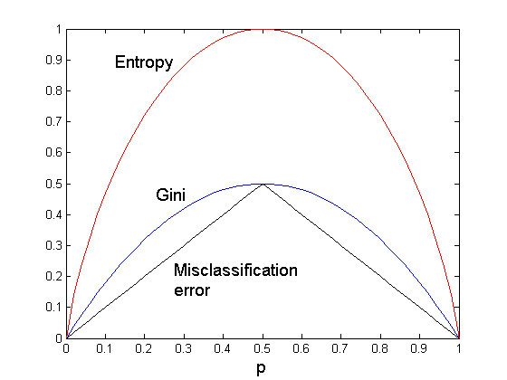
Comparison among Impurity Measures
For a 2-class problem:

Slide 44
Decision Tree Learning
We use labeled data to obtain a suitable decision tree for future predictions
We want a decision tree that works well on unseen data, while asking as few questions as possible

Slide 45
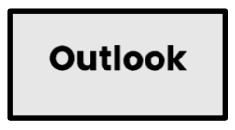
Decision Tree Learning
Basic step: choose an attribute and, based on its values, split the data into smaller sets
Recursively repeat this step until we can surely decide the label

Slide 46
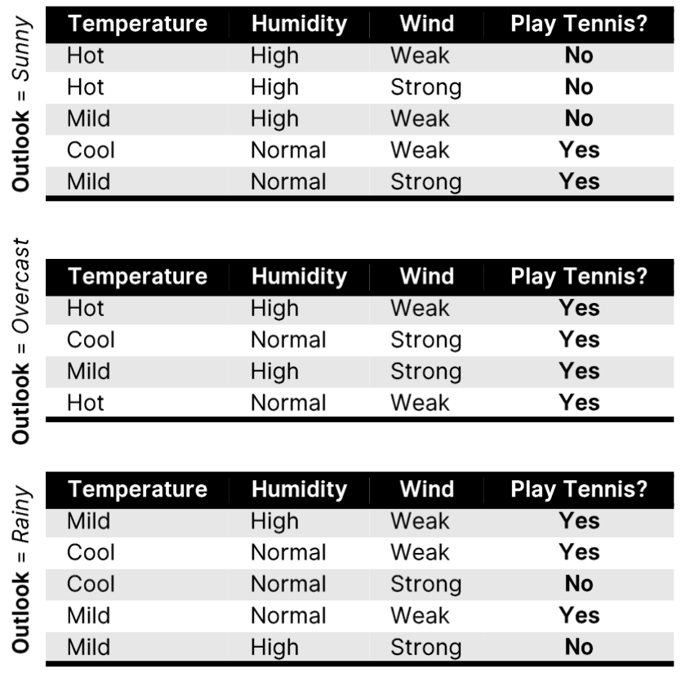
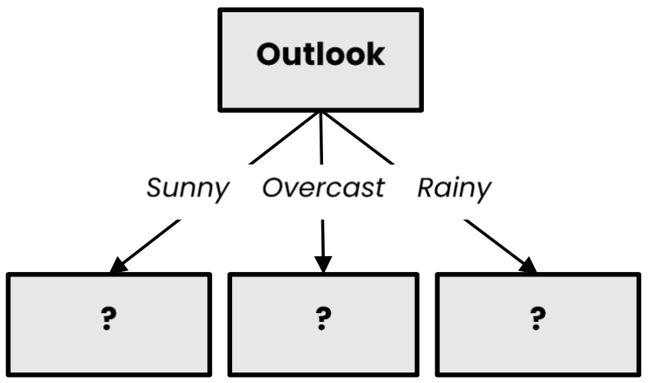
Decision Tree Learning
Basic step: choose an attribute and, based on its values, split the data into smaller sets
Recursively repeat this step until we can surely decide the label

Slide 47
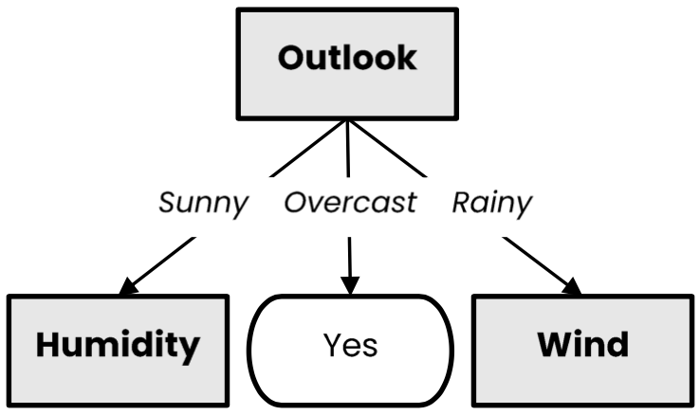
Decision Tree Learning
Basic step: choose an attribute and, based on its values, split the data into smaller sets
Recursively repeat this step until we can surely decide the label

Slide 48
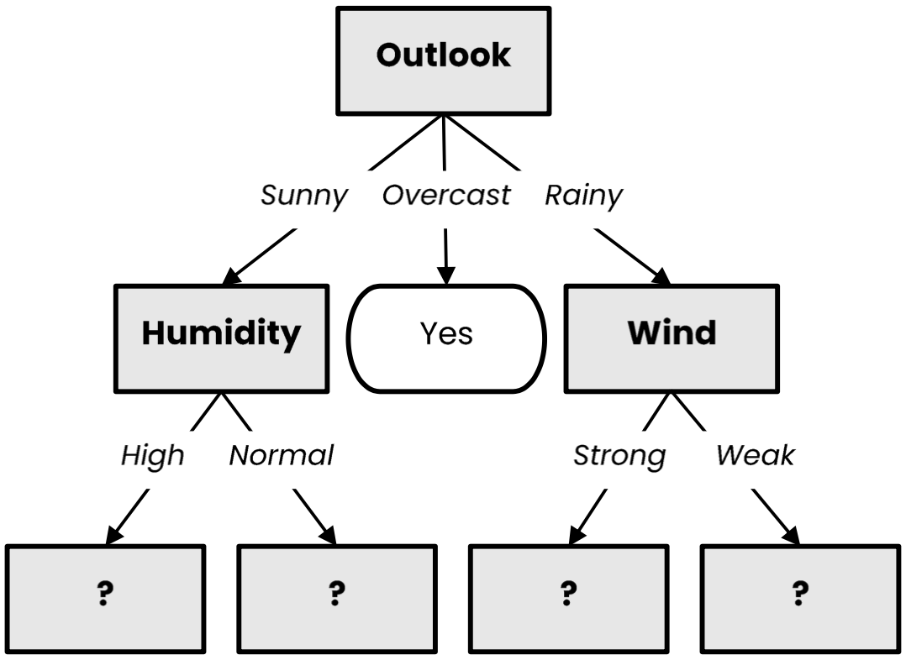
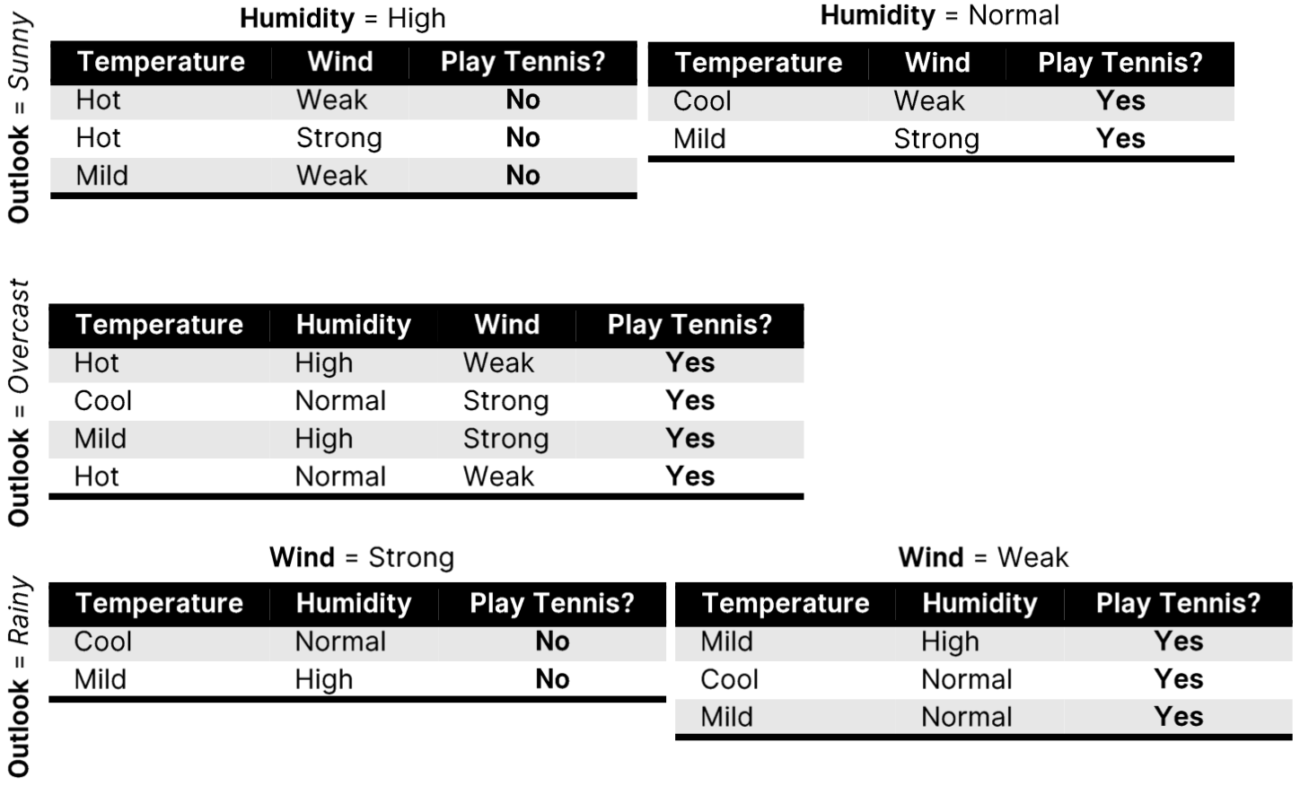
Decision Tree Learning
Basic step: choose an attribute and, based on its values, split the data into smaller sets
Recursively repeat this step until we can surely decide the label

Slide 49
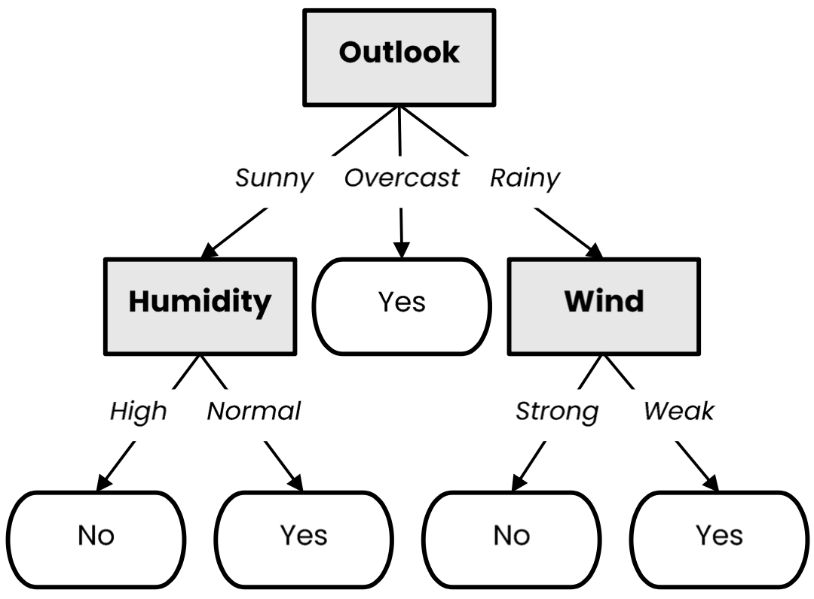
Decision Tree Learning
Basic step: choose an attribute and, based on its values, split the data into smaller sets
Recursively repeat this step until we can surely decide the label

Slide 50
Decision Tree Learning (Python)
def make_tree(X):
node = TreeNode(X)
if should_be_leaf_node(X):
node.label = majority_label(X)
else:
a = select_best_splitting_attribute(X)
for v in values(a):
𝑋_{𝑣} ={𝑥 ∈ 𝑋|𝑥[𝑎] == 𝑣}
node.children.append(make_tree(𝑋_{𝑣}))
return node

Slide 51
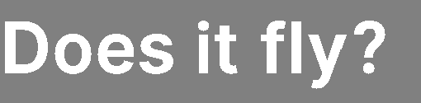
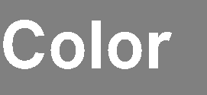
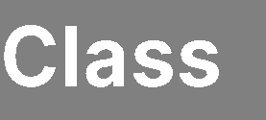


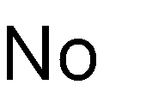
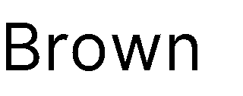
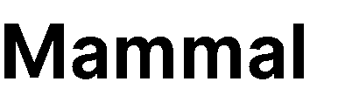
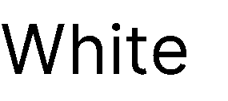
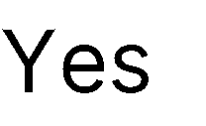

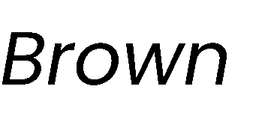
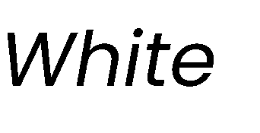
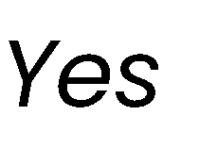
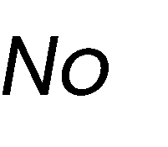
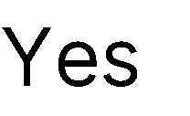
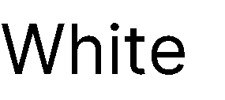

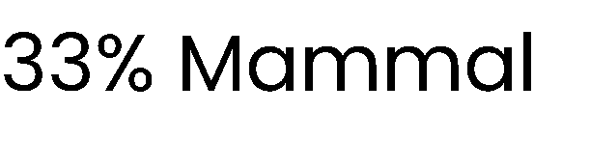
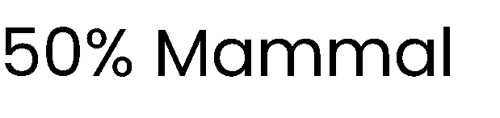
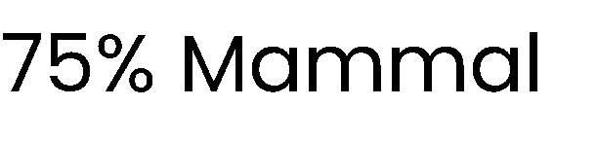
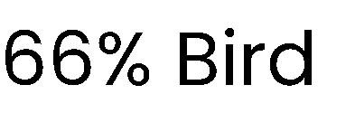
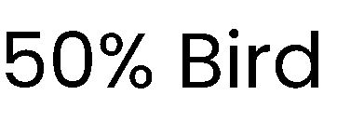
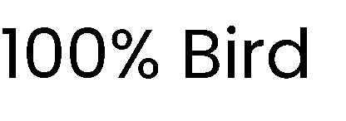
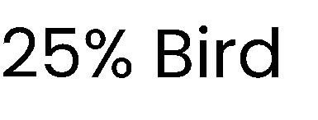
What is a good attribute?
Which attribute provides better splitting?
Why?
Because the resulting subsets are more pure
Knowing the value of this attribute gives us more information about the label
(the entropy of the subsets is lower)

Slide 52
Information Gain

Slide 53


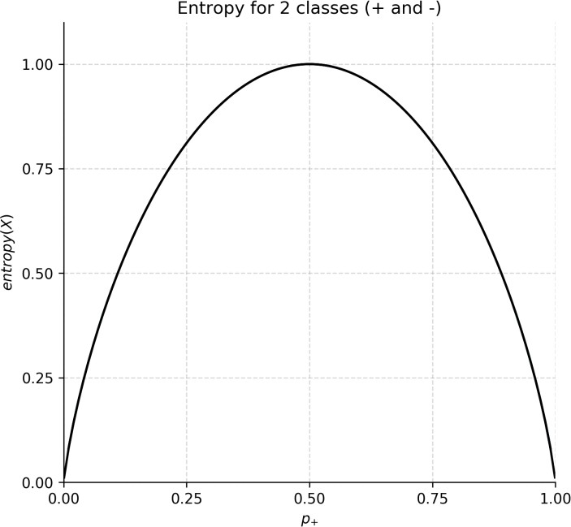






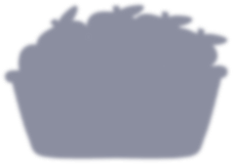















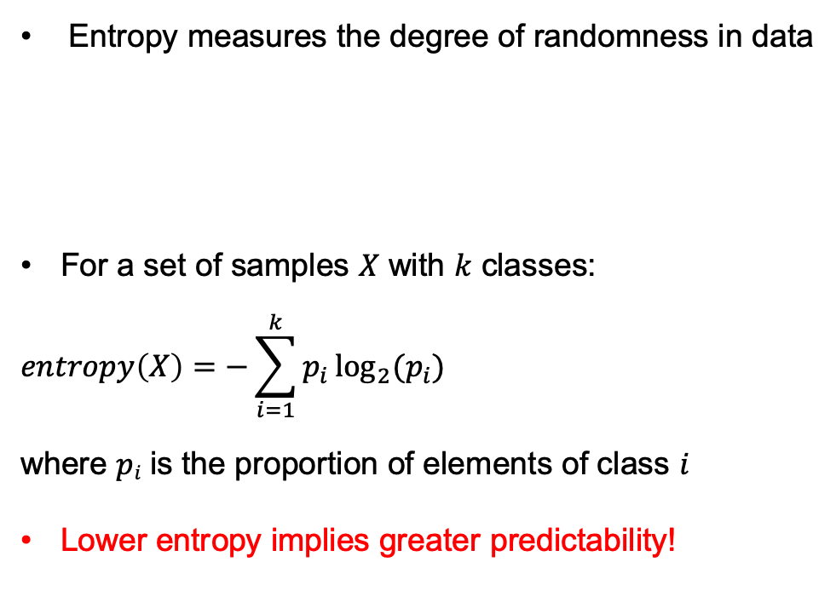
Entropy
Entropy measures the degree of randomness in data
For a set of samples $X$ with $k$ classes:
$$entropy\left(X\right)=−\sum_{i=1}^{k}{p_{i}\log_{2}{(p_{i})}}$$
where $pi$ is the proportion of elements of class $i$
Lower entropy implies greater predictability!

Slide 54
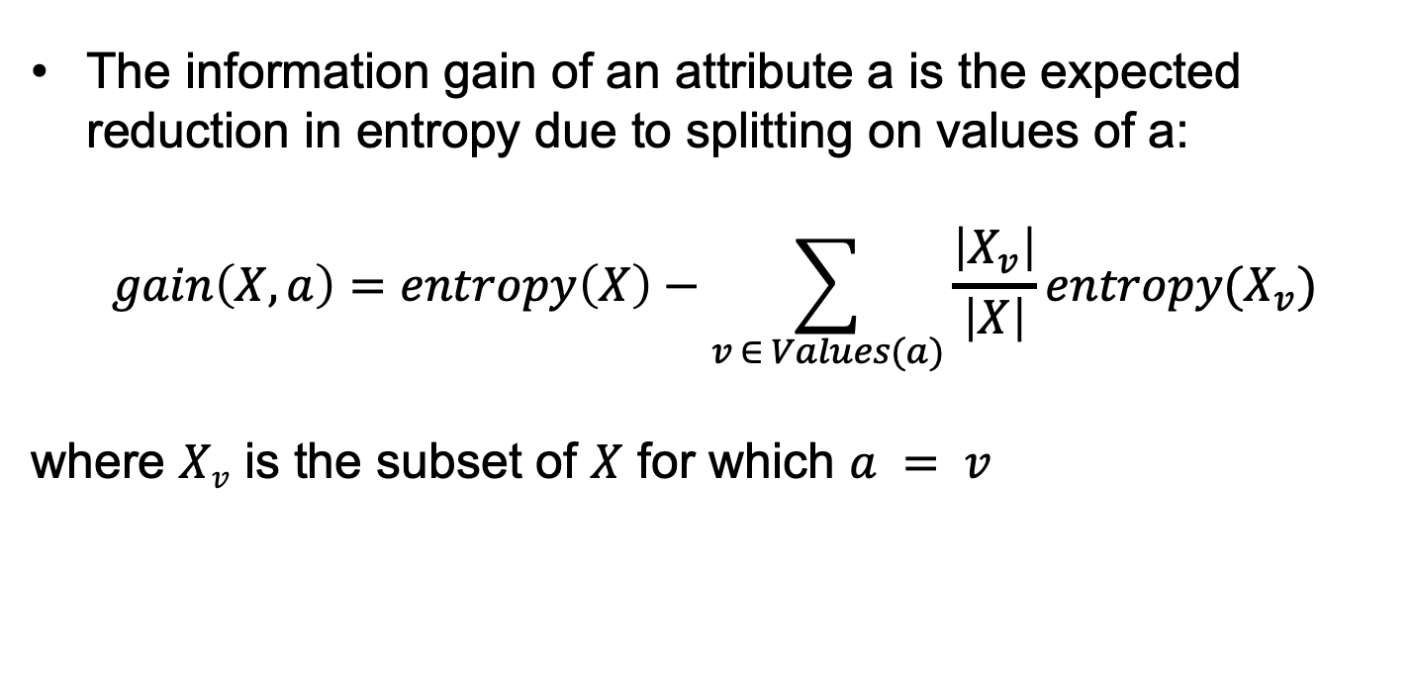
Information Gain
The information gain of an attribute a is the expected reduction in entropy due to splitting on values of a:
$$gain\left(X,a\right)=entropy\left(X\right)−\sum_{v ∈ Values(a)}{\frac{\left|X_{v}\right|}{\left|X\right|}entropy(X_{v})}$$
where $Xv$ is the subset of $X$ for which $a = v$

Slide 55
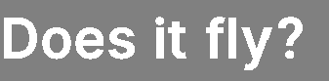
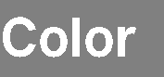
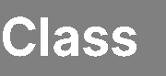

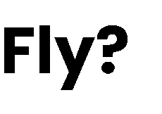
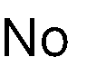
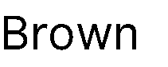
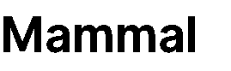
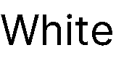
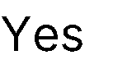
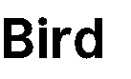
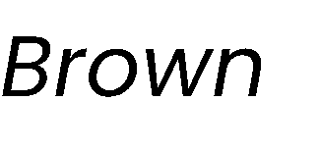
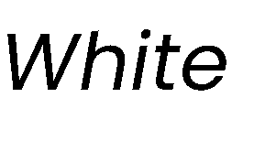
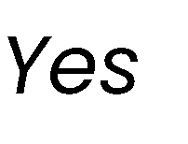
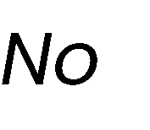






Best attribute = highest information gain
$$entropy \left(X\right)= − pmammal log2 pmammal−pbird log2 pbird=−\frac{3}{7} log2\frac{3}{7}−\frac{4}{7}log2\frac{4}{7}≈ 0.985$$

Slide 56




Best attribute = highest information gain
$$entropy \left(X\right)= − pmammal log2 pmammal−pbird log2 pbird=−\frac{3}{7} log2\frac{3}{7}−\frac{4}{7}log2\frac{4}{7}≈ 0.985$$
$$entropy (X_{color=brown}) = −\frac{1}{3} log2\frac{1}{3}−\frac{2}{3} log2\frac{2}{3}≈ 0.918$$

Slide 57



Best attribute = highest information gain
$$entropy \left(X\right)= − pmammal log2 pmammal−pbird log2 pbird=−\frac{3}{7} log2\frac{3}{7}−\frac{4}{7}log2\frac{4}{7}≈ 0.985$$
$$entropy (X_{color=brown}) = −\frac{1}{3} log2\frac{1}{3}−\frac{2}{3} log2\frac{2}{3}≈ 0.918$$
$$entropy (X_{color=white}) =1$$

Slide 58

Best attribute = highest information gain
$$entropy \left(X\right)= − pmammal log2 pmammal−pbird log2 pbird=−\frac{3}{7} log2\frac{3}{7}−\frac{4}{7}log2\frac{4}{7}≈ 0.985$$
$$entropy (X_{color=brown}) = −\frac{1}{3} log2\frac{1}{3}−\frac{2}{3} log2\frac{2}{3}≈ 0.918$$
$$entropy (X_{color=white}) =1$$
$$gain \left(X, color\right)=0.985−\frac{3}{7}∙0.918−\frac{4}{7}∙1≈0.020$$

Slide 59



Best attribute = highest information gain
$$entropy \left(X\right)= − pmammal log2 pmammal−pbird log2 pbird=−\frac{3}{7} log2\frac{3}{7}−\frac{4}{7}log2\frac{4}{7}≈ 0.985$$
$$entropy (X_{color=brown}) = −\frac{1}{3} log2\frac{1}{3}−\frac{2}{3} log2\frac{2}{3}≈ 0.918$$
$$entropy (X_{color=white}) =1$$
$$gain \left(X, color\right)=0.985−\frac{3}{7}∙0.918−\frac{4}{7}∙1≈0.020$$
$$entropy (X_{fly=yes}) =0$$

Slide 60




Best attribute = highest information gain
$$entropy \left(X\right)= − pmammal log2 pmammal−pbird log2 pbird=−\frac{3}{7} log2\frac{3}{7}−\frac{4}{7}log2\frac{4}{7}≈ 0.985$$
$$entropy (X_{color=brown}) = −\frac{1}{3} log2\frac{1}{3}−\frac{2}{3} log2\frac{2}{3}≈ 0.918$$
$$entropy (X_{color=white}) =1$$
$$gain \left(X, color\right)=0.985−\frac{3}{7}∙0.918−\frac{4}{7}∙1≈0.020$$
$$entropy (X_{fly=no}) = −\frac{3}{4} log2\frac{3}{4}−\frac{1}{4} log2\frac{1}{4}≈ 0. 811$$
$$entropy (X_{fly=yes}) =0$$

Slide 61

Best attribute = highest information gain
In practice, we compute $entropy(X)$ only once!
$$entropy \left(X\right)= − pmammal log2 pmammal−pbird log2 pbird=−\frac{3}{7} log2\frac{3}{7}−\frac{4}{7}log2\frac{4}{7}≈ 0.985$$
$$entropy (X_{color=brown}) = −\frac{1}{3} log2\frac{1}{3}−\frac{2}{3} log2\frac{2}{3}≈ 0.918$$
$$entropy (X_{color=white}) =1$$
$$gain \left(X, color\right)=0.985−\frac{3}{7}∙0.918−\frac{4}{7}∙1≈0.020$$
$$entropy (X_{fly=no}) = −\frac{3}{4} log2\frac{3}{4}−\frac{1}{4} log2\frac{1}{4}≈ 0. 811$$
$$entropy (X_{fly=yes}) =0$$
$$gain \left(X, fly\right)=0.985−\frac{3}{7}∙0−\frac{4}{7}∙0.811≈0.521$$

Slide 62
Top-Down Induction of Decision Tree ID3: ID = Iterative Dichotomiser
Step 1: A<- the "best" decision attribute for next node
Step 2: Assign A as decision attribute for node
Step 3: For each value of A create new descendant
Step 4: Sort training examples to leaf node according to the attribute value of the branch
Step 5: If all training examples are perfectly classified (same value of target attribute) stop, else iterate over new leaf nodes.

Slide 63

ID3 Algorithm (Python)
# ID = Iterative Dichotomiser
def ID3(X):
node = TreeNode(X)
if all_points_have_same_class(X):
node.label = majority_label(X)
else:
a = select_attribute_with_highest_information_gain(X)
if gain(X, a) == 0:
node.label = majority_label(X)
else:
for v in values(a):
$Xv=\{x∈X | x[a] == v\}$
node.children.append(ID3($Xv$))
return node

Slide 64
Gini Impurity

Slide 65



















Gini Impurity
Gini impurity measures how often a randomly chosen example would be incorrectly labeled if it was randomly labeled according to the label distribution
For a set of samples $X$ with $k$ classes:
$$gini\left(X\right)=1−\sum_{i=1}^{k}{p_{i}^{2}}$$
where $pi$ is the proportion of elements of class $i$
Can be used as an alternative to entropy for selecting attributes!

Slide 66






Best attribute = highest impurity decrease
In practice, we compute $gini(X)$ only once!
$$gini \left(X\right)=1 −{\left(\frac{3}{7}\right)}^{2}−{\left(\frac{4}{7}\right)}^{2}≈ 0.489$$
$$gini (X_{color=brown}) =1 −{\left(\frac{1}{3}\right)}^{2}−{\left(\frac{2}{3}\right)}^{2}≈ 0.444$$
$$gini (X_{color=white}) =0.5$$
$$△gini \left(X, color\right)=0.489−\frac{3}{7}∙0.444−\frac{4}{7}∙0.5≈0.013$$
$$gini (X_{fly=no}) =1 −{\left(\frac{3}{4}\right)}^{2}−{\left(\frac{1}{4}\right)}^{2}≈ 0. 375$$
$$gini (X_{fly=yes}) =0$$
$$△gini \left(X, fly\right)=0.489−\frac{3}{7}∙0−\frac{4}{7}∙0.375≈0.274$$

Slide 67

Entropy versus Gini Impurity
Entropy and Gini Impurity give similar results in practice
They only disagree in about 2% of cases
“Theoretical Comparison between the Gini Index and Information Gain Criteria” [Răileanu & Stoffel, AMAI 2004]
Entropy might be slower to compute, because of the log

Slide 68
Pruning

Slide 69
Pruning
Pruning is a technique that reduces the size of a decision tree by removing branches of the tree which provide little predictive power
It is a regularization method that reduces the complexity of the final model, thus reducing overfitting
Decision trees are prone to overfitting!
Pruning methods:
Pre-pruning: Stop the tree building algorithm before it fully classifies the data
Post-pruning: Build the complete tree, then replace some non-leaf nodes with leaf nodes if this improves validation error

Slide 70








Pre-pruning
Minimum threshold on entropy
𝜽_{𝒆𝒏𝒕} = 𝟎. 𝟒
Pre-pruning implies early stopping:
If some condition is met, the current node will not be split, even if it is not 100% pure
It will become a leaf node with the label of the majority class in the current set
(the class distribution could be used as prediction confidence)
Common stopping criteria include setting a threshold on:
Entropy (or Gini Impurity) of the current set
Number of samples in the current set
Gain of the best-splitting attribute
Depth of the tree
$$entropy(54|5)= 0.29 < θent$$
Stop, even if node can be split
91.52% confidence

Slide 71





Post-pruning
Prune nodes in a bottom-up manner, if it decreases validation error

Slide 72

Post-pruning
Prune nodes in a bottom-up manner, if it decreases validation error

Slide 73

Post-pruning
Prune nodes in a bottom-up manner, if it decreases validation error

Slide 74
Handling Numerical Attributes

Slide 75










































Handling numerical attributes
How does the ID3 algorithm handle numerical attributes?
Any numerical attribute would almost always bring entropy down to zero
This means it will completely overfit the training data
Consider a numerical value for humidity

Slide 76

























Handling numerical attributes
Numerical attributes have to be treated differently
Find the best splitting value
Gain of numerical attribute $a$ if we split at value $t$
$$gain\left(X, a, t\right)= entropy\left(X\right)−\frac{\left|X_{a≤t}\right|}{\left|X\right|}entropy\left(X_{a≤t}\right)−\frac{\left|X_{a>t}\right|}{\left|X\right|}entropy\left(X_{a>t}\right)$$
Mean of each consecutive pair
Sort

Slide 77
Handling numerical attributes
Numerical attributes have to be treated differently
Find the best splitting value
$$gain\left(X, a, t\right)= entropy\left(X\right)−\frac{\left|X_{a≤t}\right|}{\left|X\right|}entropy\left(X_{a≤t}\right)−\frac{\left|X_{a>t}\right|}{\left|X\right|}entropy\left(X_{a>t}\right)$$
Mean of each consecutive pair
Sort
$$gain \left(X, humidity, 83.5\right)=$$

Slide 78
Handling numerical attributes
Numerical attributes have to be treated differently
Find the best splitting value
$$gain\left(X, a, t\right)= entropy\left(X\right)−\frac{\left|X_{a≤t}\right|}{\left|X\right|}entropy\left(X_{a≤t}\right)−\frac{\left|X_{a>t}\right|}{\left|X\right|}entropy\left(X_{a>t}\right)$$
Mean of each consecutive pair
Sort
$$gain \left(X, humidity, 83.5\right)=0.94$$

Slide 79

Handling numerical attributes
Numerical attributes have to be treated differently
Find the best splitting value
$$gain\left(X, a, t\right)= entropy\left(X\right)−\frac{\left|X_{a≤t}\right|}{\left|X\right|}entropy\left(X_{a≤t}\right)−\frac{\left|X_{a>t}\right|}{\left|X\right|}entropy\left(X_{a>t}\right)$$
Mean of each consecutive pair
Sort
$$gain \left(X, humidity, 83.5\right)=0.94−\frac{7}{14}∙0.59$$

Slide 80

Handling numerical attributes
Numerical attributes have to be treated differently
Find the best splitting value
$$gain\left(X, a, t\right)= entropy\left(X\right)−\frac{\left|X_{a≤t}\right|}{\left|X\right|}entropy\left(X_{a≤t}\right)−\frac{\left|X_{a>t}\right|}{\left|X\right|}entropy\left(X_{a>t}\right)$$
Mean of each consecutive pair
Sort
$$gain \left(X, humidity, 83.5\right)=0.94−\frac{7}{14}∙0.59−\frac{7}{14}∙0.98$$

Slide 81

Handling numerical attributes
Numerical attributes have to be treated differently
Find the best splitting value
$$gain\left(X, a, t\right)= entropy\left(X\right)−\frac{\left|X_{a≤t}\right|}{\left|X\right|}entropy\left(X_{a≤t}\right)−\frac{\left|X_{a>t}\right|}{\left|X\right|}entropy\left(X_{a>t}\right)$$
Mean of each consecutive pair
Sort
$$gain \left(X, humidity, 83.5\right)=0.94−\frac{7}{14}∙0.59−\frac{7}{14}∙0.98$$
$$≈0.152$$

Slide 82















Handling numerical attributes
Numerical attributes have to be treated differently
Find the best splitting value
Mean of each consecutive pair
Gain for every candidate
Sort
83.5 is the best splitting value with an information gain of 0.152

Slide 83









Handling numerical attributes
Numerical attributes have to be treated differently
Find the best splitting value
83.5 is the best splitting value for Humidity with an information gain of 0.152
Humidity is now treated as a categorical attribute with two possible values
A new optimal split is computed at every level of the tree
A numerical attribute can be used several times in the tree, with different split values
 |  | >
 |  | >
 |  | >
 |  | >
 |  | ≤
 |  | ≤
 |  | ≤
 |  | >
 |  | ≤
 |  | ≤
 |  | ≤
 |  | >
 |  | ≤
 |  | >

Slide 84
Handling Missing Values

Slide 85













Handling missing values at training time
Data sets might have samples with missing values for some attributes
Simply ignoring them would mean throwing away a lot of information
There are better ways of handling missing values:

Slide 86






Handling missing values at training time
Data sets might have samples with missing values for some attributes
Simply ignoring them would mean throwing away a lot of information
There are better ways of handling missing values:
Set them to the most common value

Slide 87





Handling missing values at training time
Data sets might have samples with missing values for some attributes
Simply ignoring them would mean throwing away a lot of information
There are better ways of handling missing values:
Set them to the most common value
Set them to the most probable value given the label
$$P\left(Yes | Bird\right)=\frac{2}{3}= 0.66$$
$$P\left(No | Bird\right)=\frac{1}{3}= 0.33$$
$$P\left(White | Mammal\right)=1$$
$$P\left(Brown | Mammal\right)=0$$

Slide 88







Handling missing values at training time
Data sets might have samples with missing values for some attributes
Simply ignoring them would mean throwing away a lot of information
There are better ways of handling missing values:
Set them to the most common value
Set them to the most probable value given the label
Add a new instance for each possible value

Slide 89



Handling missing values at training time
Data sets might have samples with missing values for some attributes
Simply ignoring them would mean throwing away a lot of information
There are better ways of handling missing values:
Set them to the most common value
Set them to the most probable value given the label
Add a new instance for each possible value
Leave them unknown, but discard the sample when evaluating the gain of that attribute
(if the attribute is chosen for splitting, send the instances
with unknown values to all children)
$$entropy(X_{color=brown})=0$$
$$entropy(X_{color=white})=1$$
gain$\left(X | color\right)=0.985−\frac{2}{6}∙0−\frac{4}{6}∙1$
$= 0.318$

Slide 90














Handling missing values at training time
Data sets might have samples with missing values for some attributes
Simply ignoring them would mean throwing away a lot of information
There are better ways of handling missing values:
Set them to the most common value
Set them to the most probable value given the label
Add a new instance for each possible value
Leave them unknown, but discard the sample when evaluating the gain of that attribute
(if the attribute is chosen for splitting, send the instances
with unknown values to all children)
Build a decision tree on all other attributes (including label) to predict missing values
(use instances where the attribute is defined as training data)

Slide 91

Handling missing values at inference time
When we encounter a node that checks an attribute with a missing value, we explore all possibilities
Loan?
Not a student
49 years old
Unknown income
Fair credit record

Slide 92

Handling missing values at inference time
When we encounter a node that checks an attribute with a missing value, we explore all possibilities
We explore all branches and take the final prediction based on a (weighted) vote of the corresponding leaf nodes
Loan?
Not a student
49 years old
Unknown income
Fair credit record
Yes

Slide 93
C4.5 Algorithm
C4.5 algorithm is an extension of ID3 algorithm that brings several improvements:
Ability to handle both categorical (discrete) and numerical (continuous) attributes
(continuous attributes are split by finding a best-splitting threshold)
Ability to handle missing values both at training and inference time
(missing values at training are not used when information gain is computed; missing values at inference time are handled by exploring all corresponding branches)
Ability to handle attributes with different costs
Post-pruning in a bottom-up manner for removing branches that decrease validation error (i.e., that increase generalization capacity)

Slide 94



Decision Boundaries
Decision trees produce non-linear decision boundaries
Support Vector Machines
Decision Tree

Slide 95








Decision Trees: Training and Inference
Training
Inference

Slide 96
History of Decision Trees
The first regression tree algorithm
“Automatic Interaction Detection (AID)” [Morgan & Sonquist, 1963]
The first classification tree algorithm
“Theta Automatic Interaction Detection (THAID)” [Messenger & Mandel, 1972]
Decision trees become popular
“Classification and regression trees (CART)” [Breiman et al., 1984]
Introduction of the ID3 algorithm
“Induction of Decision Trees” [Quinlan, 1986]
Introduction of the C4.5 algorithm
“C4.5: Programs for Machine Learning” [Quinlan, 1993]

Slide 97
Summary
Decision trees represent a tool based on a tree-like graph of decisions and their possible outcomes
Decision tree learning is a machine learning method that employs a decision tree as a predictive model
ID3 builds a decision tree by iteratively splitting the data based on the values of an attribute with the largest information gain (decrease in entropy)
Using the decrease of Gini Impurity is also a commonly-used option in practice
C4.5 is an extension of ID3 that handles attributes with continuous values, missing values and adds regularization by pruning branches likely to overfit

Slide 98
Decision Tree Based Classification
Advantages:
Inexpensive to construct
Extremely fast at classifying unknown records
Easy to interpret for small-sized trees
Robust to noise (especially when methods to avoid overfitting are employed)
Can easily handle redundant or irrelevant attributes (unless the attributes are interacting)
Disadvantages:
Space of possible decision trees is exponentially large. Greedy approaches are often unable to find the best tree.
Does not take into account interactions between attributes
Each decision boundary involves only a single attribute

Slide 99
Random Forests
(Ensemble learning with decision trees)

Slide 100
Random Forests
Random Forests:
Instead of building a single decision tree and use it to make predictions, build many slightly different trees and combine their predictions
We have a single data set, so how do we obtain slightly different trees?
1. Bagging (Bootstrap Aggregating):
Take random subsets of data points from the training set to create N smaller data sets
Fit a decision tree on each subset
2. Random Subspace Method (also known as Feature Bagging):
Fit N different decision trees by constraining each one to operate on a random subset of features

Slide 101







Bagging at training time
N subsets (with replacement)
Training set

Slide 102









Bagging at inference time
A test sample
75% confidence

Slide 103





































Random Subspace Method at training time
Training data

Slide 104





Random Subspace Method at inference time
A test sample
66% confidence

Slide 105


































Random Forests
Tree 1
Tree 2
Random Forest
Tree N

Slide 106
History of Random Forests
Introduction of the Random Subspace Method
“Random Decision Forests” [Ho, 1995] and “The Random Subspace Method for Constructing Decision Forests” [Ho, 1998]
Combined the Random Subspace Method with Bagging. Introduce the term Random Forest (a trademark of Leo Breiman and Adele Cutler)
“Random Forests” [Breiman, 2001]

Slide 107
Ensemble Learning
Ensemble Learning:
Method that combines multiple learning algorithms to obtain performance improvements over its components
Random Forests are one of the most common examples of ensemble learning
Other commonly-used ensemble methods:
Bagging: multiple models on random subsets of data samples
Random Subspace Method: multiple models on random subsets of features
Boosting: train models iteratively, while making the current model focus on the mistakes of the previous ones by increasing the weight of misclassified samples

Slide 108

Boosting
All samples have the same weight

Slide 109
Boosting
All samples have the same weight
Reweight based on model’s mistakes

Slide 110
Boosting
Next model sees weighted samples

Slide 111
Boosting
Reweight based on current model’s mistakes

Slide 112
Boosting

Slide 113





Boosting

Slide 114
Summary
Ensemble Learning methods combine multiple learning algorithms to obtain performance improvements over its components
Commonly-used ensemble methods:
Bagging (multiple models on random subsets of data samples)
Random Subspace Method (multiple models on random subsets of features)
Boosting (train models iteratively, while making the current model focus on the mistakes of the previous ones by increasing the weight of misclassified samples)
Random Forests are an ensemble learning method that employ decision tree learning to build multiple trees through bagging and random subspace method.
They rectify the overfitting problem of decision trees!

Slide 115
Decision Trees and Random Forest (Python)
from sklearn.tree import DecisionTreeClassifier
from sklearn.ensemble import RandomForestClassifier
clf = DecisionTreeClassifier(criterion = "entropy", min_samples_leaf = 3)
# Lots of parameters: criterion = "gini" / "entropy";
# max_depth;
# min_impurity_split;
clf.fit(X, y) # It can only handle numerical attributes!
# Categorical attributes need to be encoded, see LabelEncoder and OneHotEncoder
clf.predict([x]) # Predict class for x
clf.feature_importances_ # Importance of each feature
clf.tree_ # The underlying tree object
clf = RandomForestClassifier(n_estimators = 20) # Random Forest with 20 trees

